Slide 1

CSE 350 Digital Electronics and Pulse Techniques
Analog to Digital Converter (ADC)
Course Instructor: Shomen Kundu (SDU)
Mail: shomen.kundu@bracu.ac.bd
Desk: 4N139

Slide 2
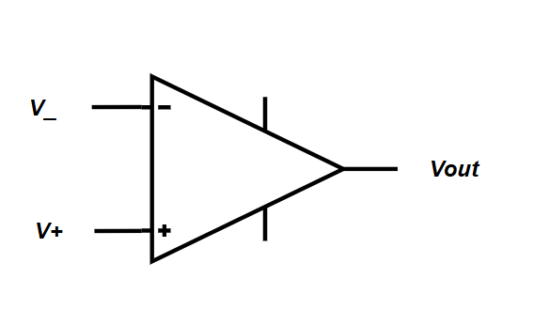



Op-Amp Review
Important terminals of Op-Amp
$V_{+}$→ Non-Inverting ( Positive ) input terminal
$V_{−}$→ Inverting ( Negative ) input terminal
$V_{H}$→ Higher power supply terminal
$V_{L}$→ Lower power supply terminal
$V_{out}$→ Output terminal
$$V_{H}$$
$$V_{L}$$

Slide 3
Op-Amp Review
Operational Amplifier can be used for different configurations
Open Loop → Comparator, Used in ADC
Negative Feedback →Amplifier, Used in DAC
Positive Feedback → Signal generator, Schmitt Trigger

Slide 4



Op-Amp Review
For open loop configuration
$$If V_{+}>V_{−} , V_{out}=High (logic 1 )$$
$$If V_{+}<V_{−} , V_{out}=Low (logic 0 )$$
$$V_{H}$$
$$V_{L}$$

Slide 5
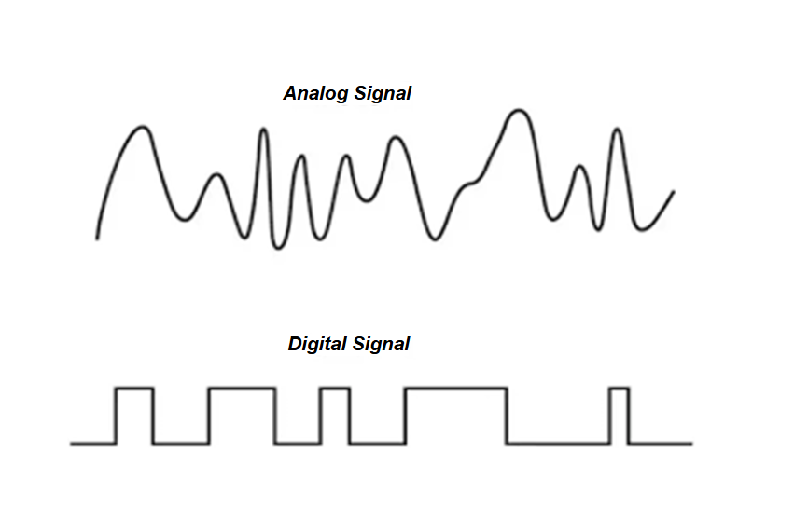
Analog to Digital Converter (ADC)
Signal can be classified into two broad categories.
Analog Signal ii. Digital Signal

Slide 6
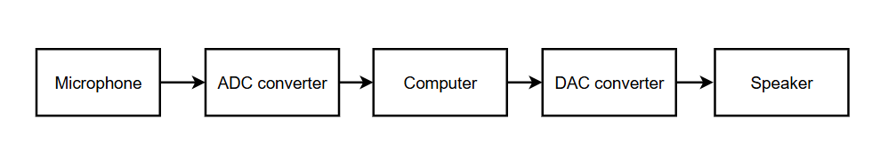
Analog to Digital Converter (ADC)
Physical world’s information are mostly analog. Analog means data could take
any real value at each instant of time.
In order to store/process we use digital data in our computers and microprocessor
Digital data means binary bit of strings.

Slide 7
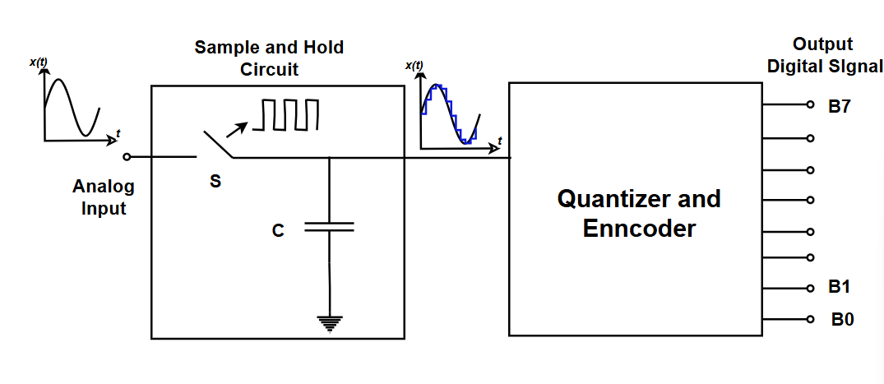
A/D conversion process

Slide 8

Sampling
Sampling is the process of converting a continuous-time signal into a discrete-time signal by taking measurements at specific intervals in time.
A theorem,
$$f_{s}>2∗f$$
$T_{s}=\frac{1}{f_{s}}$

Slide 9
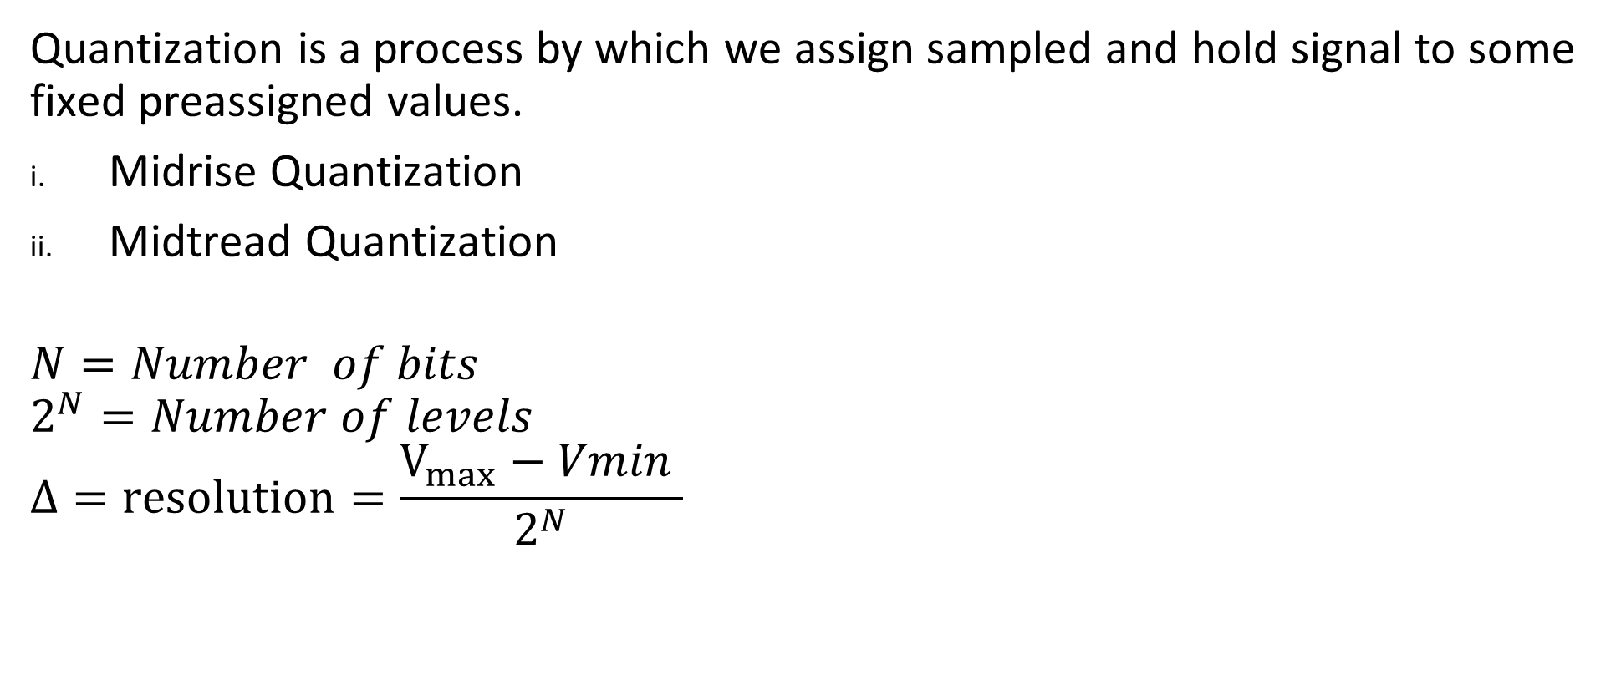
Quantization:
Quantization is a process by which we assign sampled and hold signal to some fixed preassigned values.
Midrise Quantization
Midtread Quantization
$$N=Number of bits$$
$$2^{N}=Number of levels$$
$$Δ=resolution=\frac{V_{max}−Vmin }{2^{N}}$$

Slide 10

Encoding
We can choose binary values for each of the level.
$Number of bits=Ceil (log2\left( Number of levels \right))$
Assign lower Q level to 0
Then increase one for each next level

Slide 11
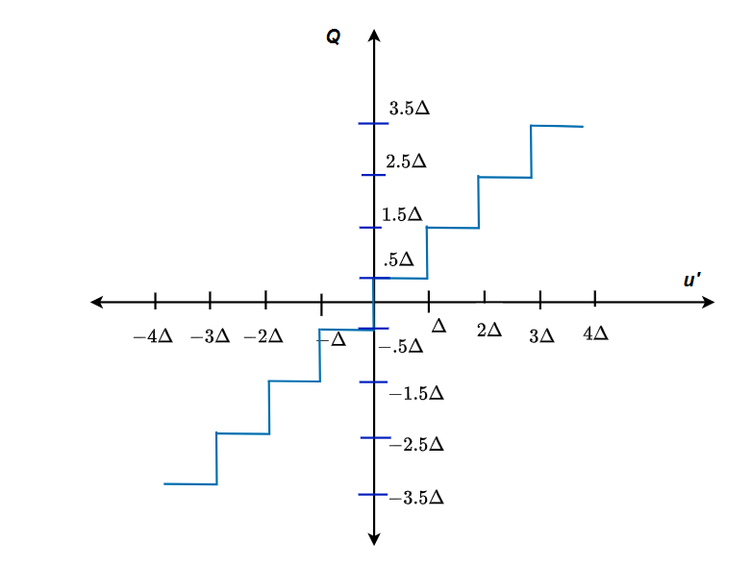
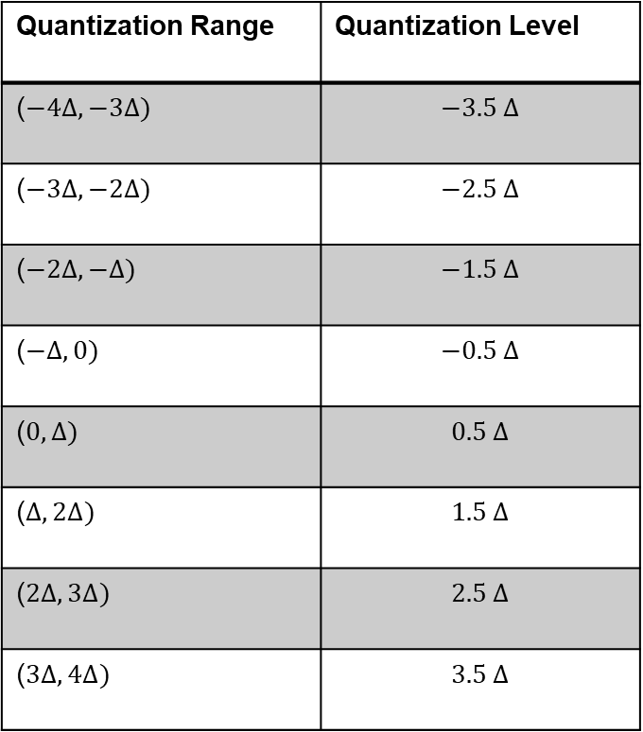
Midrise Quantization:
Quantization Range | Quantization Level
($−4∆, −3∆)$ | $$−3.5 ∆$$
($−3∆, −2∆)$ | $$−2.5 ∆$$
($−2∆, −∆)$ | $$−1.5 ∆$$
($−∆, 0)$ | $$−0.5 ∆$$
($0, ∆)$ | $$0.5 ∆$$
($∆, 2∆)$ | $$1.5 ∆$$
($2∆, 3∆)$ | $$2.5 ∆$$
($3∆, 4∆)$ | $$3.5 ∆$$

Slide 12
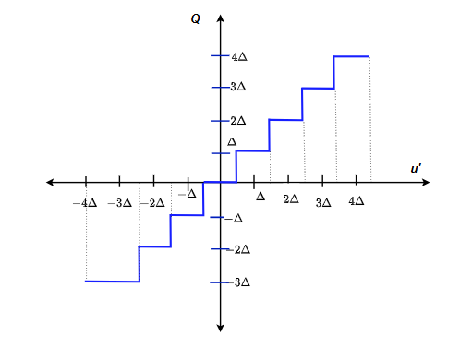
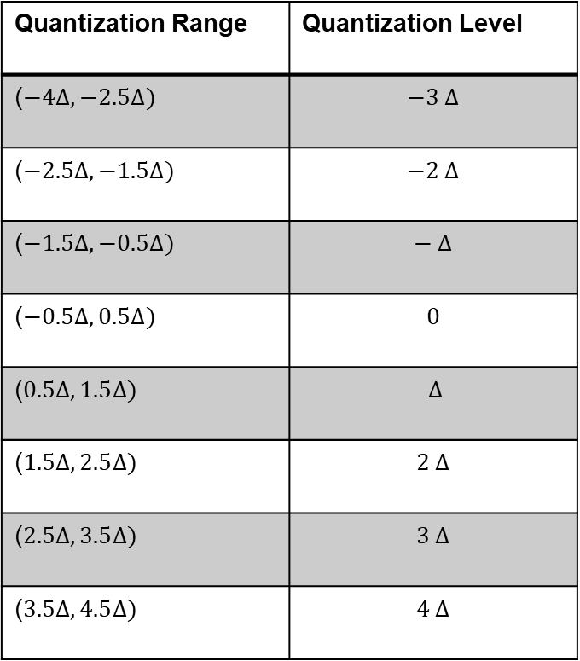
Mid tread Quantization ( Not symmetrical and Equally Spaced)
Quantization Range | Quantization Level
($−4∆, −2.5∆)$ | $$−3 ∆$$
($−2.5∆, −1.5∆)$ | $$−2 ∆$$
($−1.5∆, −0.5∆)$ | $$− ∆$$
($−0.5∆, 0.5Δ)$ | $$0$$
($0.5Δ, 1.5∆)$ | $$∆$$
($1.5∆, 2.5∆)$ | $$2 ∆$$
($2.5∆, 3.5∆)$ | $$3 ∆$$
($3.5∆, 4.5∆)$ | $$4 ∆$$

Slide 13
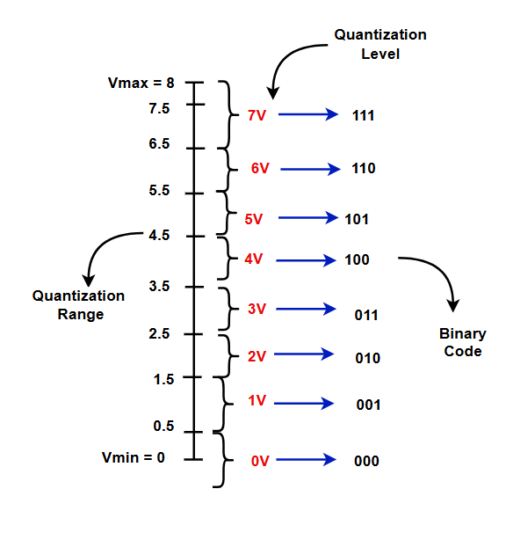
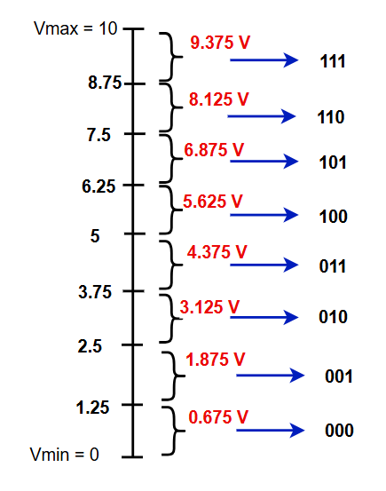
Quantization Range, Level, code
Ex: Identify which one is Mid rise and Mid tread.

Slide 14
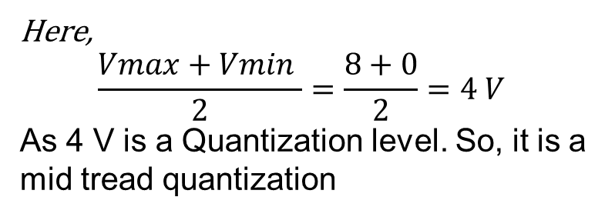
Quantization Range, Level, code
Here,
$$\frac{Vmax+Vmin }{2}=\frac{8+0}{2}=4 V$$
As 4 V is a Quantization level. So, it is a mid tread quantization

Slide 15
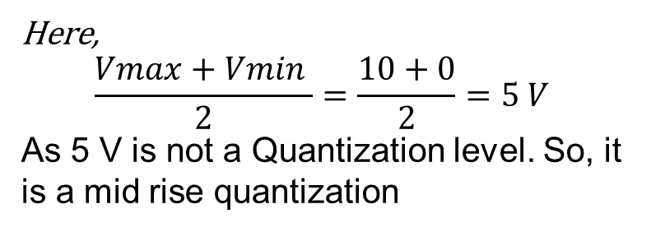
Quantization Range, Level, code
Ex: Identify which one is Mid rise and Mid tread.
Here,
$$\frac{Vmax+Vmin }{2}=\frac{10+0}{2}=5 V$$
As 5 V is not a Quantization level. So, it is a mid rise quantization

Slide 16
Flash A/D converter
Features of the Flash A/D converter
This converter is very fast.
It requires one clock cycle to convert the analog to digital data.
It requires a lot components.

Slide 17
Op-Amp
For open loop configuration
$$If V_{+}>V_{−} , V_{out}=High (logic 1 )$$
$$If V_{+}<V_{−} , V_{out}=Low (logic 0 )$$

Slide 18
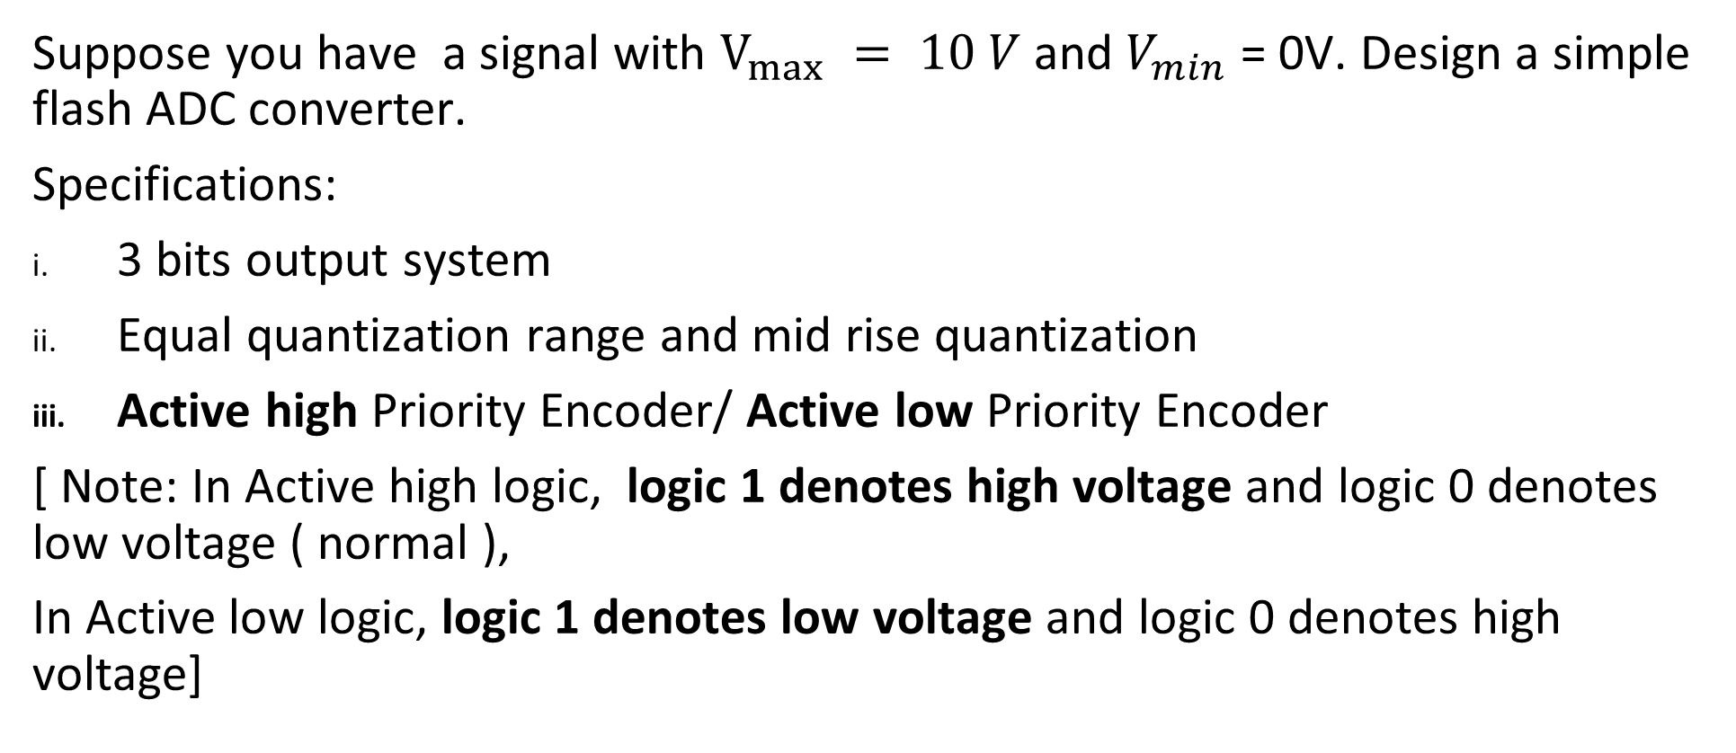
Flash ADC design
Suppose you have a signal with $V_{max} = 10 V$ and $V_{min}$ = 0V. Design a simple flash ADC converter.
Specifications:
3 bits output system
Equal quantization range and mid rise quantization
Active high Priority Encoder/ Active low Priority Encoder
[ Note: In Active high logic, logic 1 denotes high voltage and logic 0 denotes low voltage ( normal ),
In Active low logic, logic 1 denotes low voltage and logic 0 denotes high voltage]

Slide 19
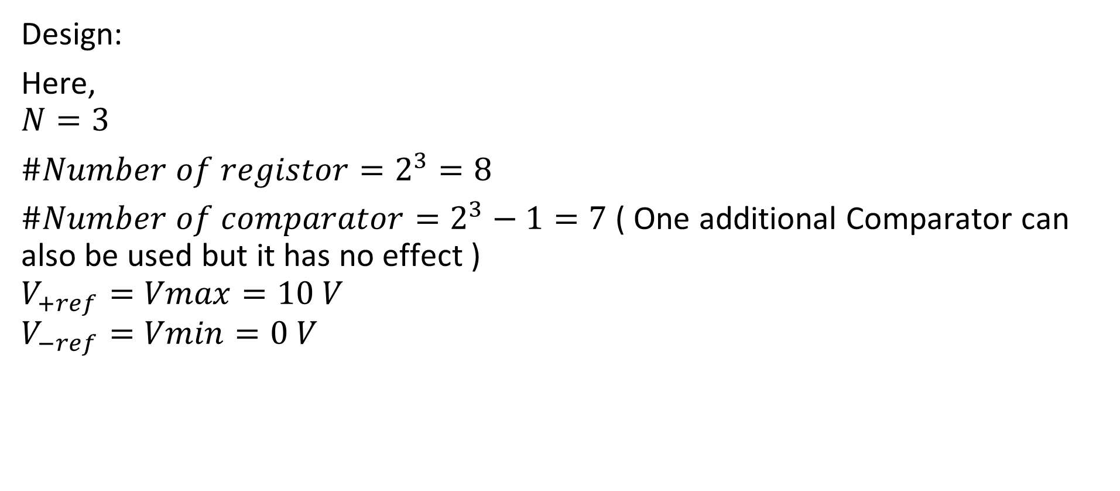
Flash ADC design
Design:
Here,
$$N=3$$
$\#Number of registor=2^{3}=8$
$\#Number of comparator=2^{3}−1=7$ ( One additional Comparator can also be used but it has no effect )
$$V_{+ref}=Vmax=10 V$$
$$V_{−ref}=Vmin=0 V$$

Slide 20
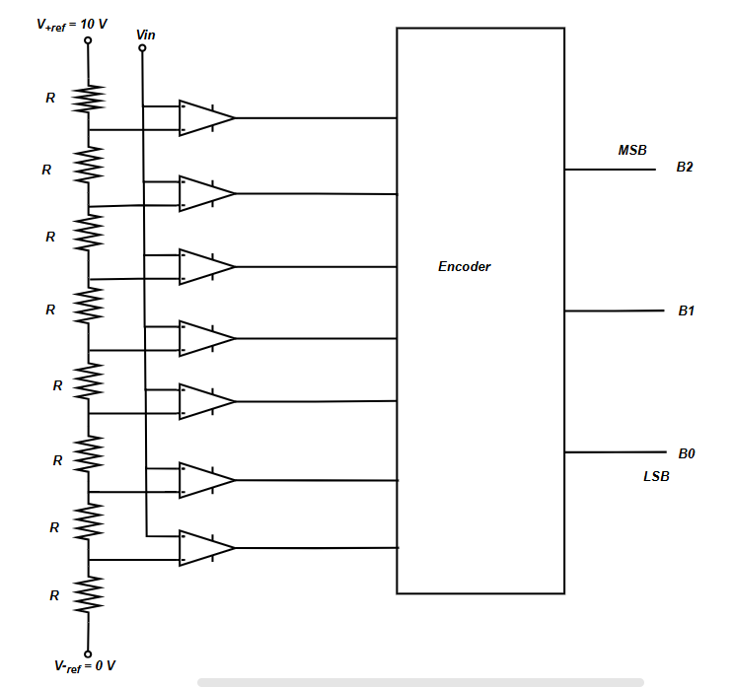
Circuit
The following is the Circuit of a 3 bits Flash ADC,
For active high priority encoder, V+ of the comparator is connected to the input.

Slide 21
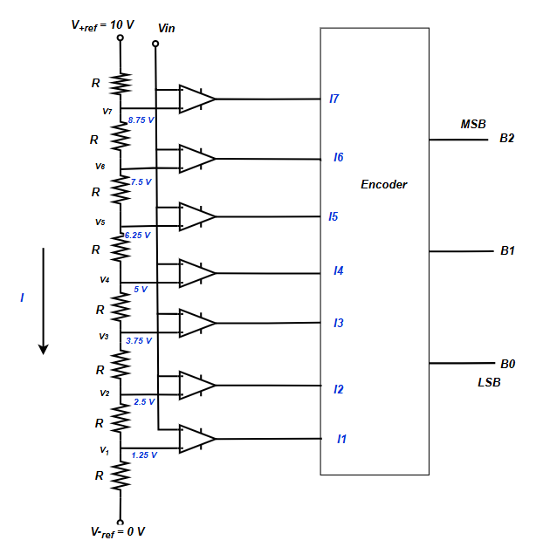
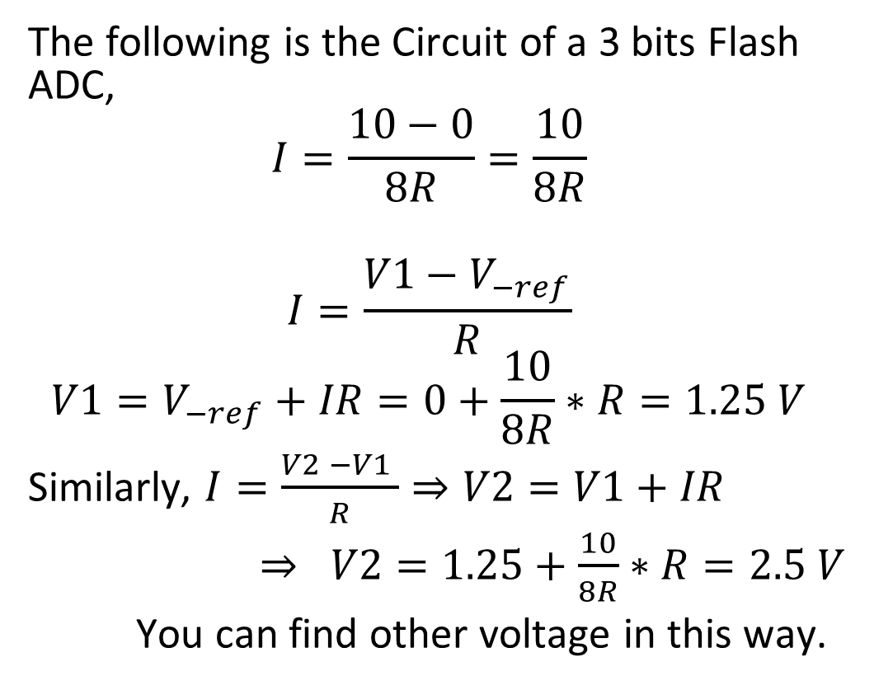
Circuit Analysis
The following is the Circuit of a 3 bits Flash ADC,
$$I=\frac{10−0}{8R}=\frac{10}{8R}$$
$$I=\frac{V1−V_{−ref}}{R}$$
$$V1=V_{−ref}+IR=0+\frac{10}{8R}∗R=1.25 V$$
Similarly, $I=\frac{V2 −V1 }{R}⇒V2=V1+IR$
$⇒ V2=1.25+\frac{10}{8R}∗R=2.5 V$
You can find other voltage in this way.

Slide 22
Circuit Analysis
Summary table:
Q Range | Q level | I7I6I5I4I3I2I1 | Binary (B2B1B0)
0 - 1.25 | 0.675 | 000 000 0
1.25 - 2.5 | 1.875 | 000 000 1
2.5 - 3.75 | 3.125 | 000 001 1
3.75 – 5 | 4.375 | 000 011 1
5 – 6.25 | 5.625 | 000 111 1
6.25 – 7.5 | 6.875 | 001 111 1
7.5 – 8.75 | 8.125 | 011 111 1
8.75 - 10 | 9.375 | 111 111 1

Slide 23
Circuit Analysis
Encoder Truth Table:
( V+ of the comparator is connected to the Input )
Encoder can be implemented using
the combinational network.
I7I6I5I4I3I2I1 | Binary (B2B1B0)
000 000 0 | 000
000 000 1 | 001
000 001 1 | 010
000 011 1 | 011
000 111 1 | 100
001 111 1 | 101
011 111 1 | 110
111 111 1 | 111

Slide 24
Circuit Analysis
Encoder Truth Table:
( For active low priority encoder V- of the comparator is connected to the Input )
Encoder can be implemented using
the combinational network.
I7I6I5I4I3I2I1 | Binary (B2B1B0)
111 111 1 | 000
111 111 0 | 001
111 110 0 | 010
111 100 0 | 011
111 000 0 | 100
110 000 0 | 101
1 000 000 | 110
000 000 0 | 111

Slide 25

Quantization Error
Quantization Error = |Signal value – Quantized vale|
Max Quantization Error = $∆/2$ ( $∆$ = resolution )

Slide 26
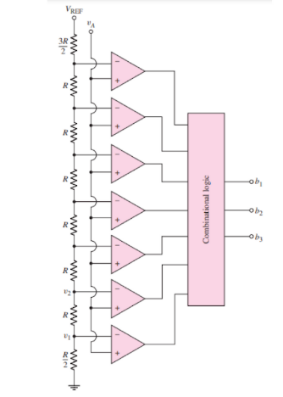
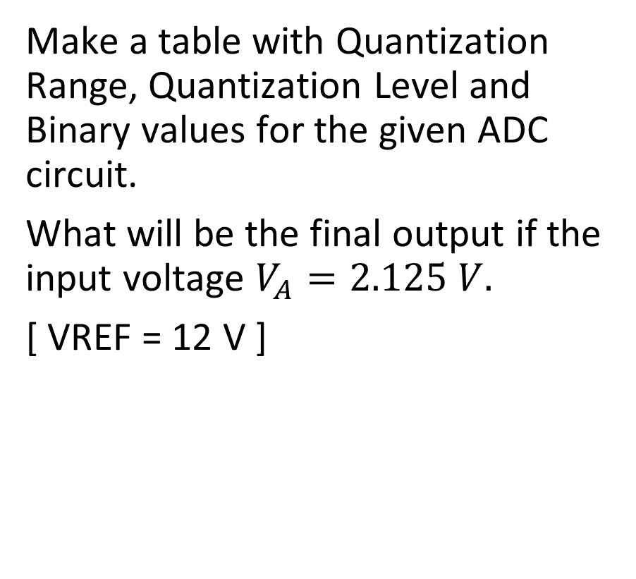
Problem:
Make a table with Quantization Range, Quantization Level and Binary values for the given ADC circuit.
What will be the final output if the input voltage $V_{A}=2.125 V.$
[ VREF = 12 V ]

Slide 27
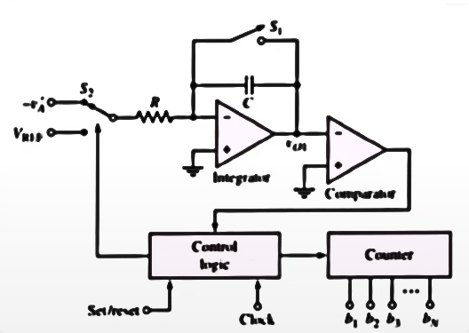
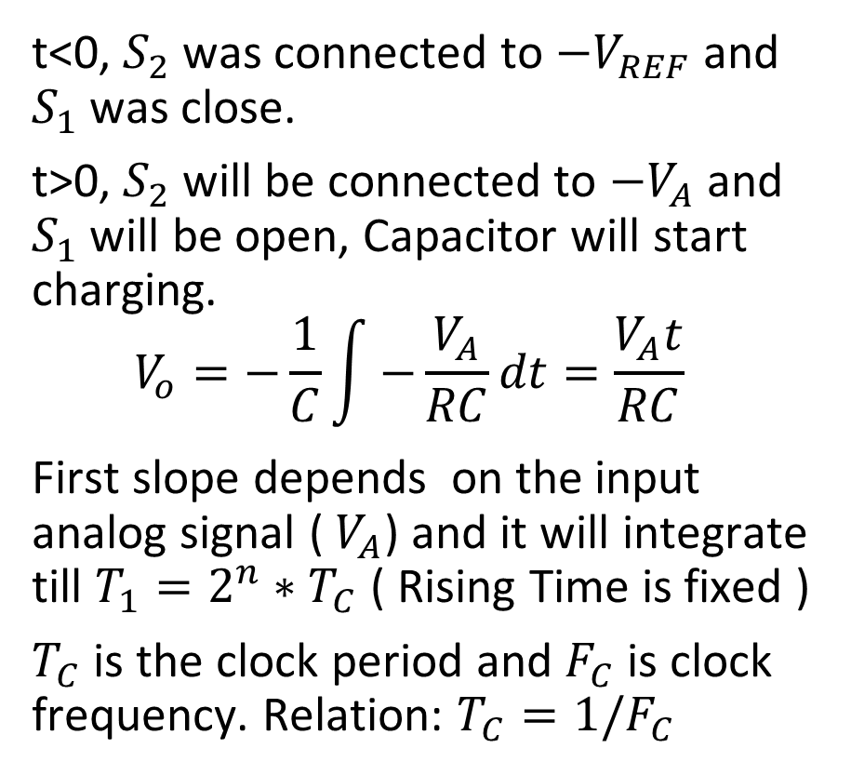
Dual Slope ADC
t<0, $S_{2}$ was connected to $−V_{REF}$ and $S_{1}$ was close.
t>0, $S_{2}$ will be connected to $−V_{A}$ and $S_{1}$ will be open, Capacitor will start charging.
$$V_{o}=−\frac{1}{C}\int{−\frac{V_{A}}{RC}dt}=\frac{V_{A}t}{RC}$$
First slope depends on the input analog signal ( $V_{A}$) and it will integrate till $T_{1}=2^{n}∗T_{C}$ ( Rising Time is fixed )
$T_{C}$ is the clock period and $F_{C}$ is clock frequency. Relation: $T_{C}=1/F_{C}$

Slide 28
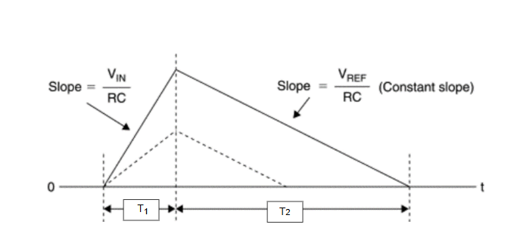
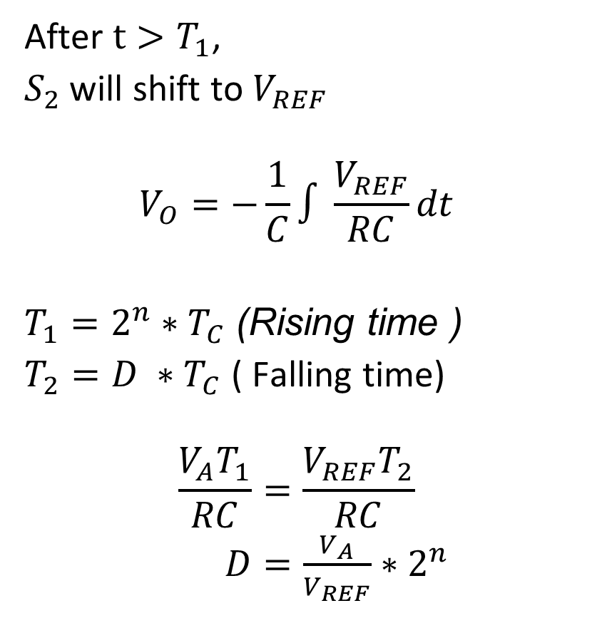
Dual Slope ADC
After $t>T_{1}$,
$S_{2}$ will shift to $V_{REF}$
$$V_{O}=−\frac{1}{C}∫\frac{V_{REF}}{RC}dt$$
$T_{1}=2^{n}∗T_{C}$(Rising time )
$T_{2}=D ∗T_{C}$ ( Falling time)
$$\frac{V_{A}T_{1}}{RC}=\frac{V_{REF}T_{2}}{RC}$$
$D=\frac{V_{A}}{V_{REF}}∗2^{n}$

Slide 29
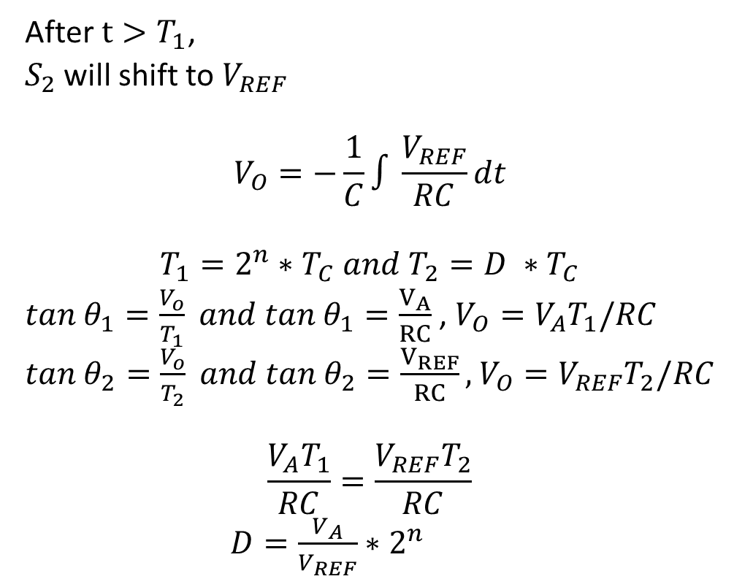
Dual Slope ADC
After $t>T_{1}$,
$S_{2}$ will shift to $V_{REF}$
$$V_{O}=−\frac{1}{C}∫\frac{V_{REF}}{RC}dt$$
$$T_{1}=2^{n}∗T_{C} and T_{2}=D ∗T_{C}$$
$tan{ θ}_{1}=\frac{V_{o}}{T_{1}} and tan{ θ}_{1}=\frac{V_{A}}{RC}$ , $V_{O}=V_{A}T_{1}/RC$
$tan{ θ}_{2}=\frac{V_{o}}{T_{2}} and tan{ θ}_{2}=\frac{V_{REF}}{RC},$ $V_{O}=V_{REF}T_{2}/RC$
$$\frac{V_{A}T_{1}}{RC}=\frac{V_{REF}T_{2}}{RC}$$
$D=\frac{V_{A}}{V_{REF}}∗2^{n}$

Slide 30
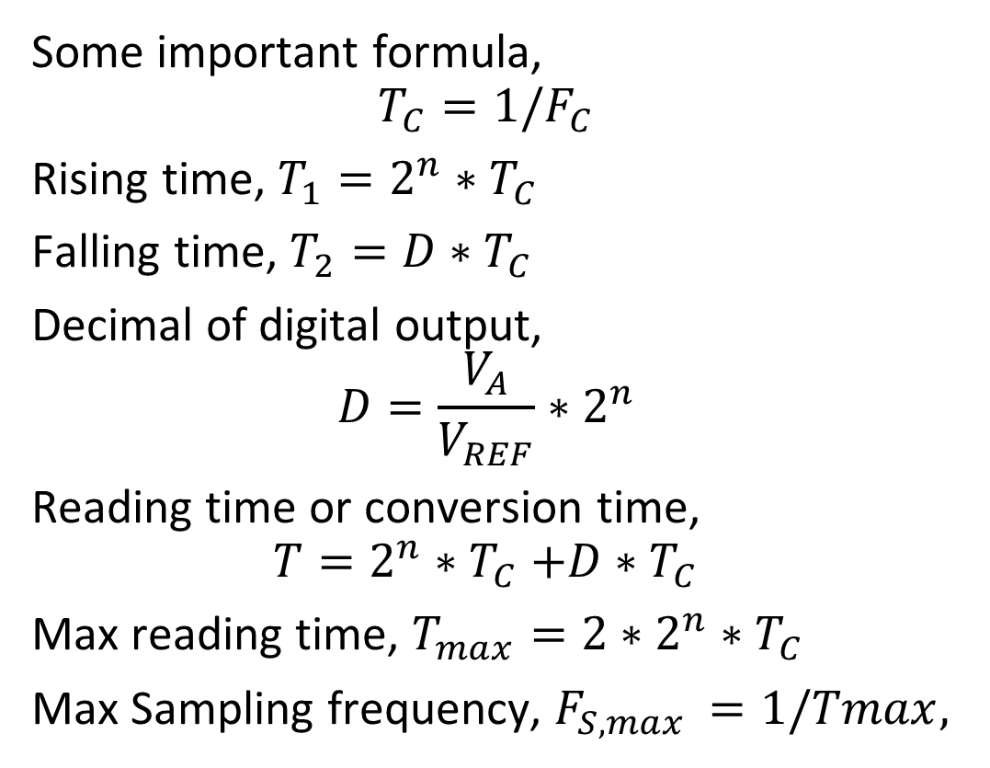
Dual Slope ADC
Some important formula,
$$T_{C}=1/F_{C}$$
Rising time, $T_{1}=2^{n}∗T_{C}$
Falling time, $T_{2}=D∗T_{C}$
Decimal of digital output,
$$D=\frac{V_{A}}{V_{REF}}∗2^{n}$$
Reading time or conversion time,
$$T=2^{n}{∗T}_{C}+D∗T_{C}$$
Max reading time, $T_{max}=2∗2^{n}∗T_{C}$
Max Sampling frequency, $F_{S,max }=1/Tmax,$

Slide 31
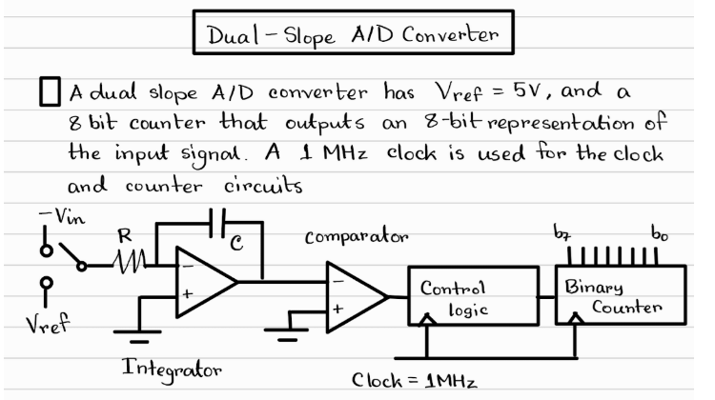

Slide 32
